Slide 1

SEO ONTOLOGY
Ontology-based Recommendations To Gain SERP Ranking

Slide 2
Group # 08
Group Members :
Maria Farooq (R047)
Nimra Bibi (R020)
Sahrish Munir (M010)

Slide 3

Agenda :
Problem Statement
Motivation
Contribution
Introduction
Overview of Concepts
Literature
Flowchart
Methodology
Results
Conclusion
Future Directions
References

Slide 4
Problem Statement
Why We Need SEO Ontology?
Lack of standardized framework for organizing SEO components
Different platforms use different optimization methods
The absence of a unified strategy adds complexity to SEO efforts
Existing methodologies lack comprehensive coverage of semantic
relationships, user intent analysis, and dynamic algorithm updates.

Slide 5
Motivation
The desire for a structured framework to efficiently organize SEO
elements.
Simplifying the complexity arising from diverse optimization
strategies across platforms.
Enhancing the effectiveness and efficiency of SEO efforts through
a unified approach.
Filling the gaps in existing methodologies by incorporating semantic
relationships, user intent analysis, and dynamic algorithm updates
into the optimization process.

Slide 6
Contribution
Development of SEO Ontology Framework:
SEO Ontology is developed and available in RDF format, facilitating
interoperability and integration with other systems.
Handling Diverse Competency Questions:
SEO Ontology is designed to address a wide range of competency
questions, including simple, compound, and complex queries related
to search engine optimization.

Slide 7
Contribution
Comprehensive Structure:
SEO Ontology features 15 main classes along with 75 subclasses,
supported by 110 data properties and 20 object properties,
facilitating semantic connections and comprehensive data
representation.
Open Source Availability:
SEO Ontology is openly accessible and publicly available on GitHub
promoting collaboration, transparency, and community engagement.

Slide 8
Collaborative Contribution
Project Planning and Coordination :
Develop project plan and timeline collectively.
Collaboratively design ontology structure.
Work together to ensure semantic accuracy.
Documentation and Outreach:
Write detailed documentation about the ontology .
Create competency questions based on the ontology .
Creates introductory videos

Slide 9
Individual Contribution
Member 1 : Maria Farooq
Project implementation plan
Project poster
Classes , Sub classes and Instances Creation
Daraz use case implementation
Ontology Refinement and Error Resolution using
OOPS! Pitfall Scanner

Slide 10
Individual Contribution
Member 2 : Nimra Bibi
Video editing
Classes and Sub classes
Article writeup
Member 3 : Sahrish Munir
Data properties Insertions
Object properties Insertions
Sparql queries
Testing

Slide 11
Introduction
What is ontology? Why we need it?
Formalized framework for organizing knowledge
Specifies concepts, entities, and relationships
Uses ontology languages for standardization
Facilitates understanding, communication, reasoning
Supports interoperability, data integration

Slide 12
Introduction
What is ontology?
Ontology
Classes
Relations
Instances
Axioms

Slide 13


Introduction
Ontology Languages :
RDF
OWL
Semantics Level 1
Vocabulary based on
formally specified semantics
Defines Classes of Knowledge
Domains
Semantics Deeper Level 2
Formally describe a
knowledge domain

Slide 14
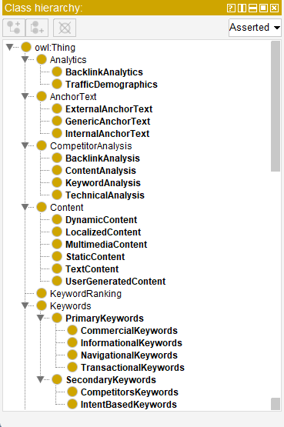
Introduction
Classes & Sub Classes :
SEO ontology classes encapsulate
key concepts of search engine
optimization.
They include elements for
optimizing websites with keywords,
content strategies, and performance
metrics.

Slide 15
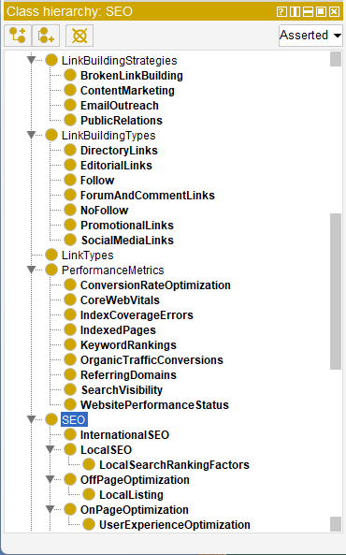
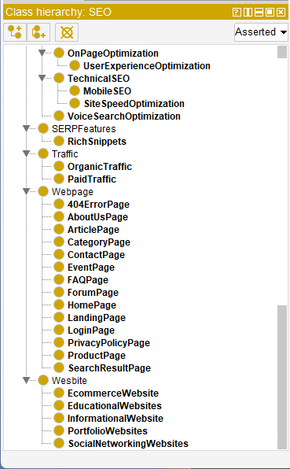
Introduction
Classes & Sub Classes :

Slide 16
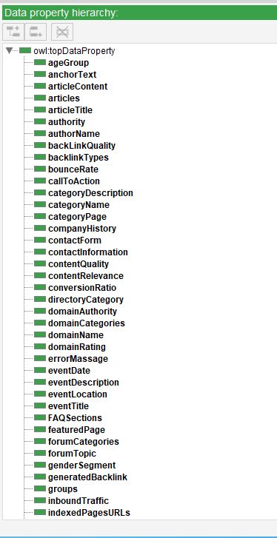
Introduction
Data Properties:
Data properties in the SEO ontology
capture essential attributes of SEO
elements.
These properties include metrics
such as keyword density, page load
time, and organic traffic volume

Slide 17
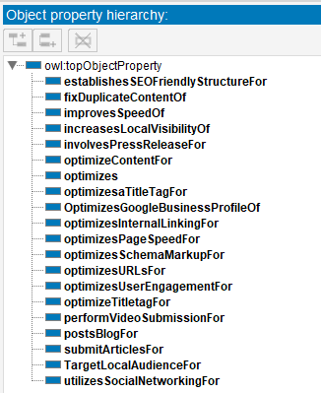
Introduction
Object Properties:
Object properties in the SEO
ontology define relationships
between different SEO elements.
These properties represent
connections such as link types,
content relationships, and
webpage relationships.

Slide 18
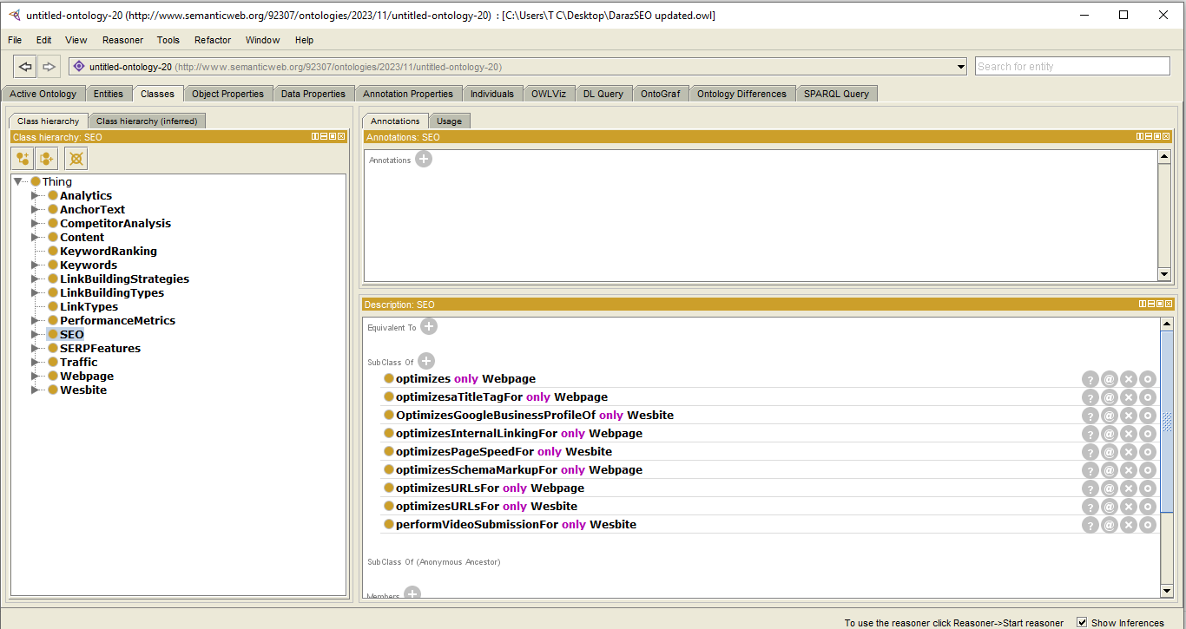
Introduction
Property Restrictions :
Property restrictions in the SEO ontology define constraints or
conditions on the values of properties.
These restrictions specify rules that must be followed when assigning
values to properties.

Slide 19
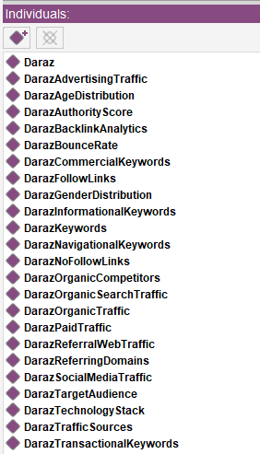
Introduction
Instances :
Instances in the SEO ontology represent
specific examples or occurrences of SEO
elements.
These instances include actual websites,
keywords, backlinks , and other SEO-
related entities.
They serve as concrete examples used
for analysis, testing, and validation within
the ontology.

Slide 20
Introduction
What is SEO?
SEO (Search Engine Optimization) is a strategy that:
Enhances website visibility on search engines
Involves optimizing content, keywords, and links
Aims to increase organic traffic and rankings
Critical for online visibility and audience reach

Slide 21
Overview Of Concepts
SEO:
Encompasses strategies and techniques to improve website
visibility, organic traffic, and search engine rankings.
SERP Features:
Refers to elements displayed on search engine results pages
(SERPs) beyond organic listings, such as rich snippets and
knowledge panels.

Slide 22
Overview Of Concepts
Analytics:
Utilizes data analysis tools to track and measure website
performance, user behavior, and SEO metrics.
Anchor Text:
Refers to the text used within hyperlinks, influencing search
engine perception of the linked page's content relevance.

Slide 23
Overview Of Concepts
Keyword Ranking:
Determines a webpage's position in search engine results for
specific keywords, impacting visibility and organic traffic.
Keywords:
Terms and phrases users search for, targeted in SEO to optimize
content relevance and attract organic traffic.

Slide 24
Overview Of Concepts
Competitor Analysis:
Involves evaluating competitors' SEO strategies, keywords,
backlinks, and content to identify opportunities and benchmarks.
Content :
Includes various types of information presented on web pages,
such as text, images, videos, and user-generated content, crucial
for SEO and user engagement.

Slide 25
Overview Of Concepts
Link Building Strategies:
Encompasses techniques to acquire backlinks from other websites,
enhancing authority and search engine rankings.
Link Building Types:
Classifies different methods of acquiring backlinks, such as
directory links, editorial links, and social media links.

Slide 26
Overview Of Concepts
Traffic :
Represents visitors accessing a website, categorized as organic
traffic (from search engines), paid traffic, and referral traffic.
Performance Metrics:
Includes quantitative measures assessing website performance,
SEO effectiveness, and user engagement.

Slide 27
Literature Review
A study on SEO ontology developed a framework to organize SEO
data, incorporating 15 main classes and 75 subclasses.
It includes 110 data properties and 20 object properties, enhancing
the semantic connections and data representation in the SEO
domain.
Further studies highlighted the importance of structured ontologies
in improving SEO practices, emphasizing the need for comprehensive
and interconnected systems.

Slide 28
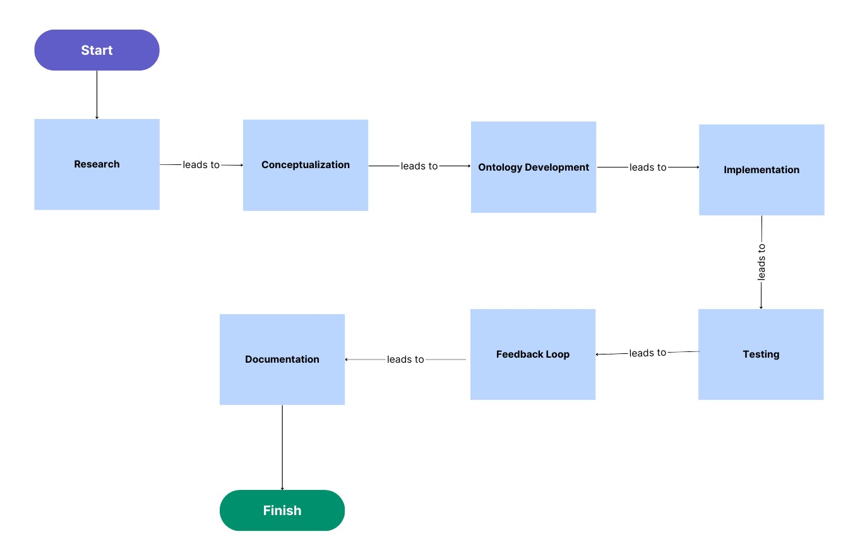
Workflow Diagram

Slide 29
Methodology
For the development of ontologies , different methodological
approaches are adopted e.g. NeOn methodology, On-To-Knowledge
methodology, and Diligent.
It provides high detail of activities that is executed while developing an
ontology.
For the development of SEO ontology, we adopt the NeOn
methodology.

Slide 30
Results
Ontology Modeling :
Developed a comprehensive ontology structure
SEO elements: classes, subclasses, data and object properties.
Validation and Consistency:
Conducted validation tests using reasoners
Ensured ontology's coherence and consistency
Confirmed accurate representation of SEO concepts

Slide 31
Results
Competency Questions:
Addressed competency questions related to SEO.
Covered keyword analysis, content optimization, and traffic
sources.
Successfully answered queries, indicating coverage of
essential SEO attributes.

Slide 32
Results
Successful Query Execution:
Competency Question :
What are the age groups represented in the traffic demographics
data?
SPARQLQuery :
PREFIXO:<http://www.semanticweb.org/92307/ontologies/2023/11/untitled-ontology-20#>
SELECT?TrafficDemographics ?string
WHERE{?TrafficDemographics O:ageGroup ?string.
}

Slide 33
Results
Successful Query Execution:
Competency Question :
What is the authority score associated with the keyword?
SPARQLQuery :
PREFIXO:<http://www.semanticweb.org/92307/ontologies/2023/11/untitled-ontology-20#>
SELECT?Keyword ?float
WHERE{?Keyword O:authority ?float.
}

Slide 34
Conclusion
Successful development and validation of the SEO ontology.
Integration of diverse SEO components, including traffic metrics,
keywords, and backlink analytics
Rigorous testing and refinement to ensure accuracy and completeness
Potential for further evolution and enhancement to address
emerging SEO trends
Commitment to ongoing research and development to optimize
SEO strategies

Slide 35
Future Directions
Explore advanced machine learning techniques to enhance
ontology-based SEO analysis.
Integrate real-time data streams for dynamic ontology updates
and insights.
Collaborate with industry experts to refine ontology for
practical application.
Develop tools and platforms for seamless integration of SEO
ontology into existing SEO workflows.

Slide 36
References
MarketBrew. (n.d.). Ontology Engineering for SEO. Retrieved from
https://marketbrew.ai/ontology-engineering-for-seo#:~:text=By%20creating%20an%20ontology%20for%20a%20
domain%2C%20it%20is%20possible,can%20also%20have%20
other%20benefits

Slide 37
References
Wikipedia. (n.d.). Semantic Web. Retrieved from
https://en.wikipedia.org/wiki/Semantic_Web
The Digital Group. (n.d.). What is the Concept of Ontology
in the Semantic Web? Retrieved from
https://blog.thedigitalgroup.com/what-is-the-concept-of-ontology-in-the-semantic-web

Slide 38
References
gfo95. (n.d.). The Evolution of SEO. Retrieved from
https://medium.com/@gfo95/the-evolution-of-seo-e3058dd10588
UKEssays. (November 2018). Literature Review on 'The
Concept of Search Engine Optimization.' Retrieved from
https://www.ukessays.com/essays/marketing/the-concept-of-search-engine-optimization-and-its-innovations-marketing-essay.php?vref=1

Slide 39
Thank You

